Slide 1
AI in game industry

Slide 2
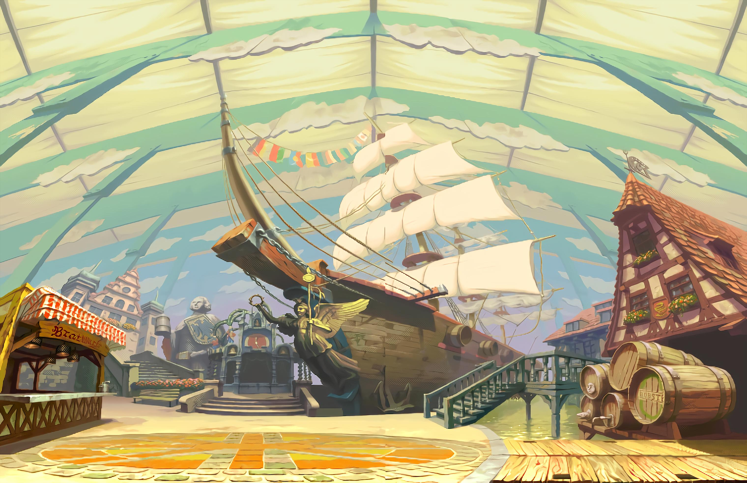
Texture creation

Slide 3
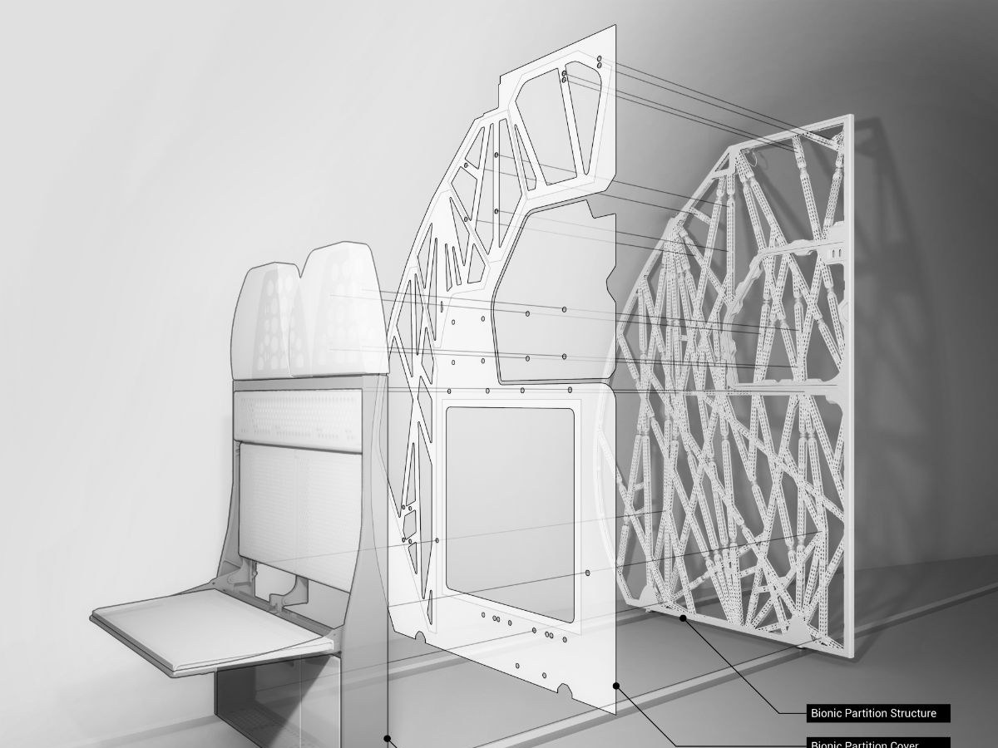
Structure design

Slide 4
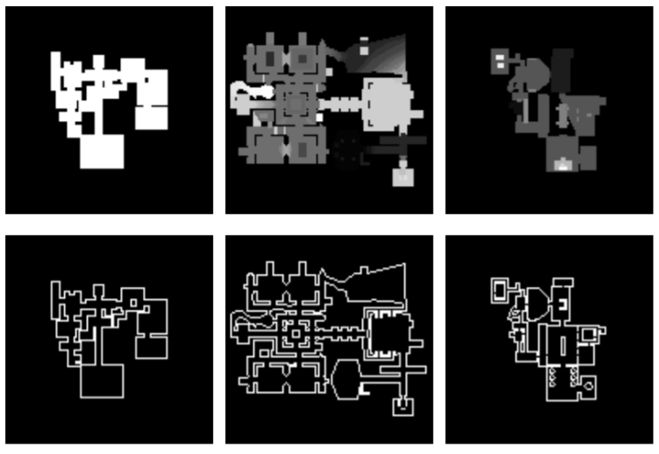
Level generation

Slide 5
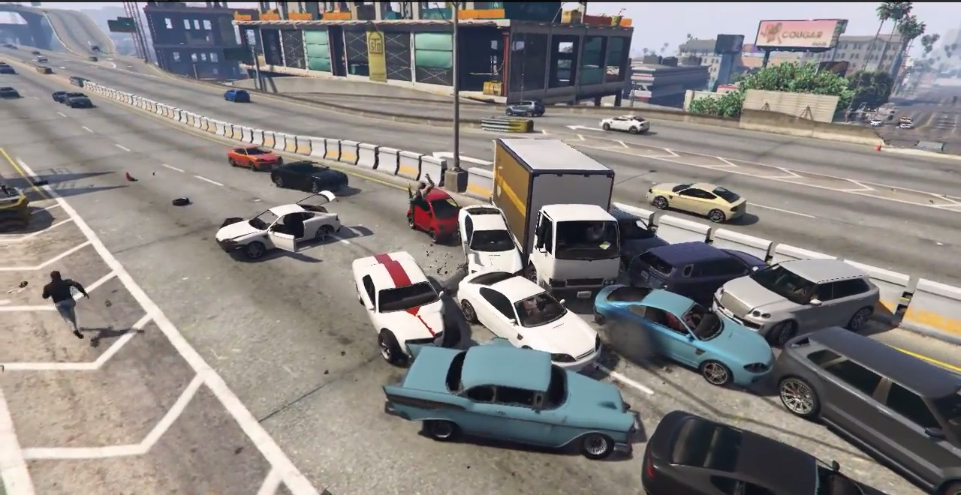
Self driving cars

Slide 6
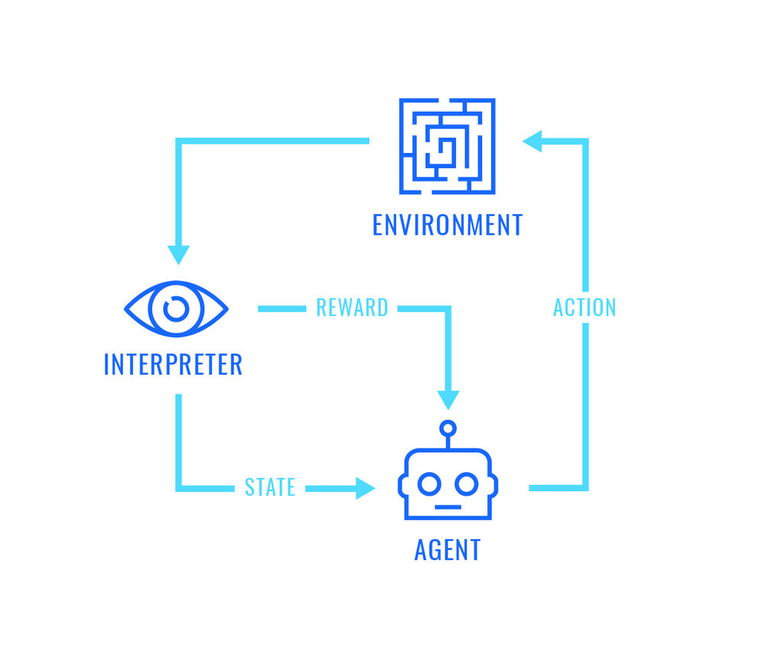
Reinforcement learning

Slide 7
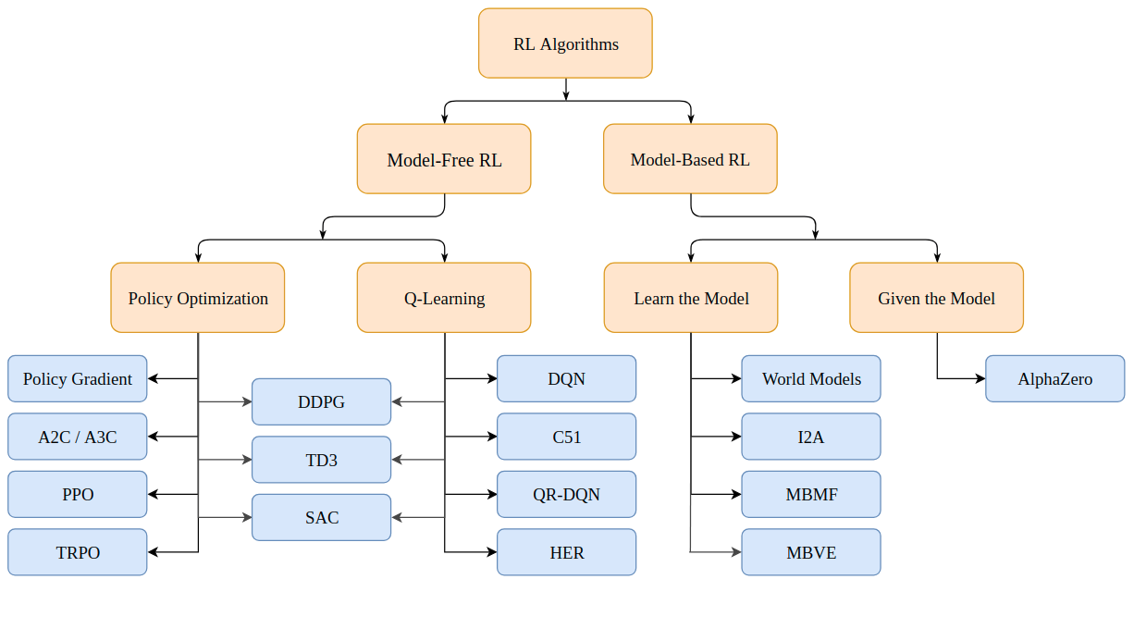
Algorithms

Slide 8
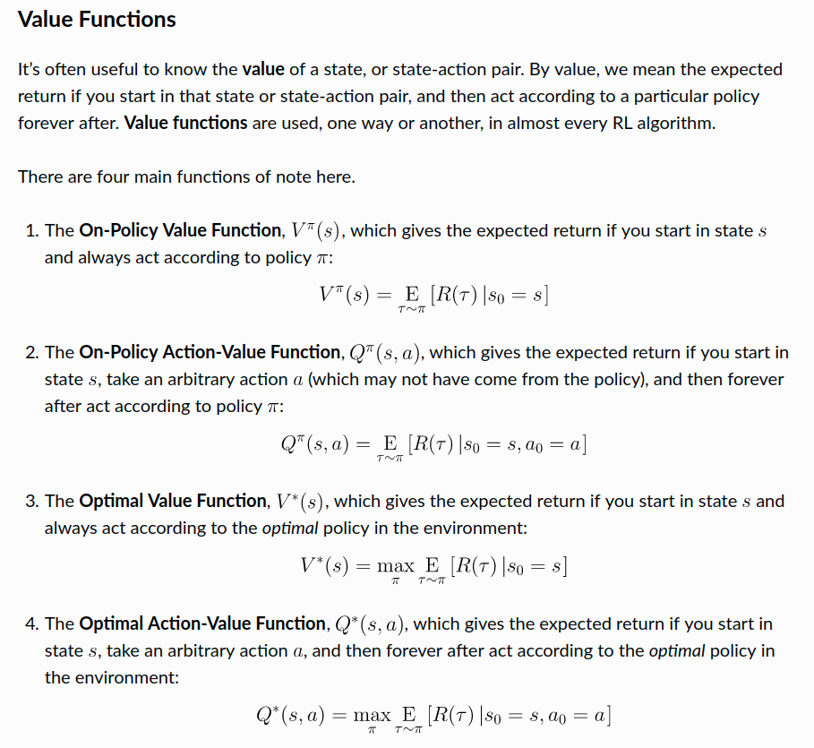

Slide 9
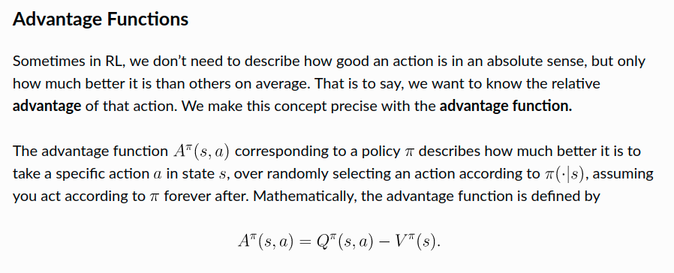

Slide 10
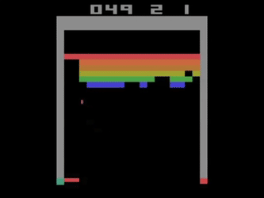
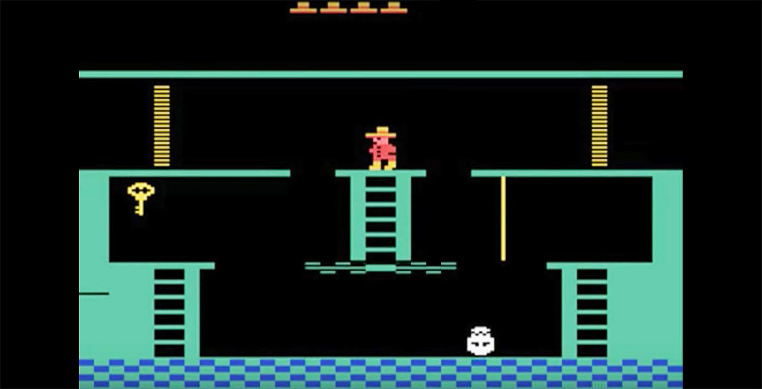
Dqn

Slide 11
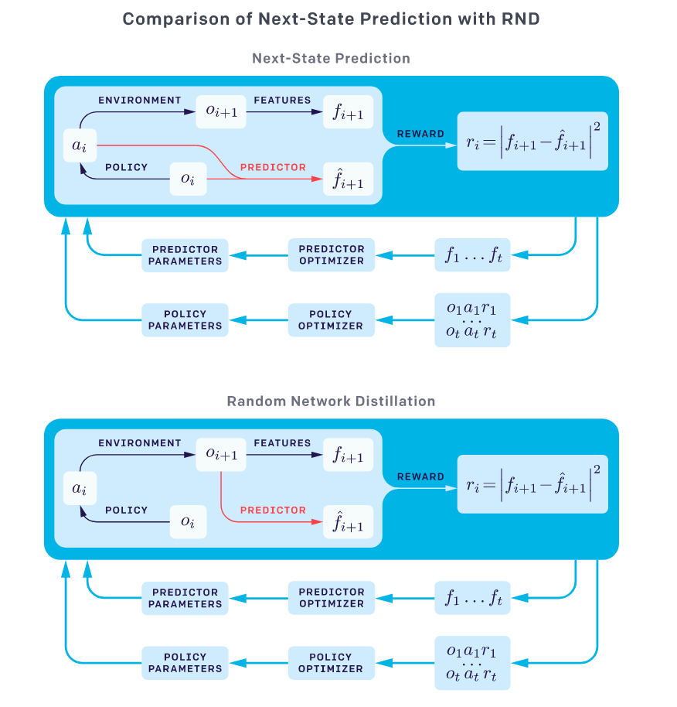
Curiosity

Slide 12
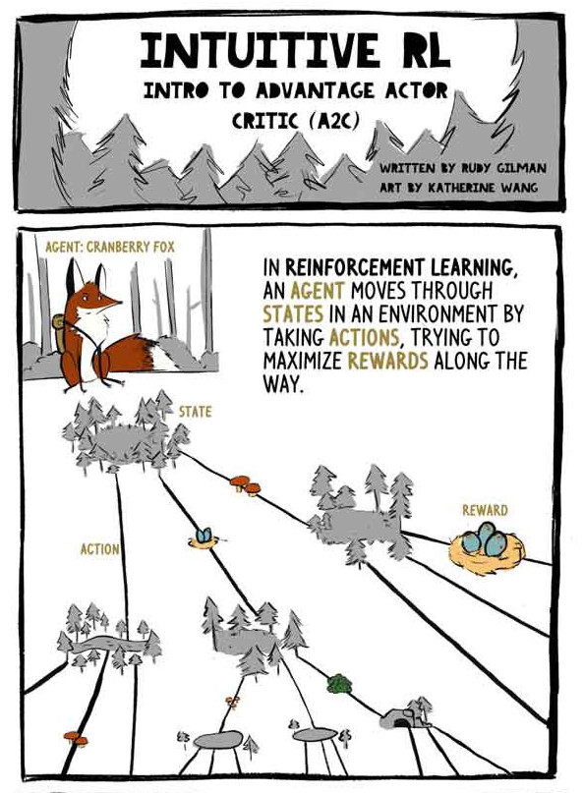
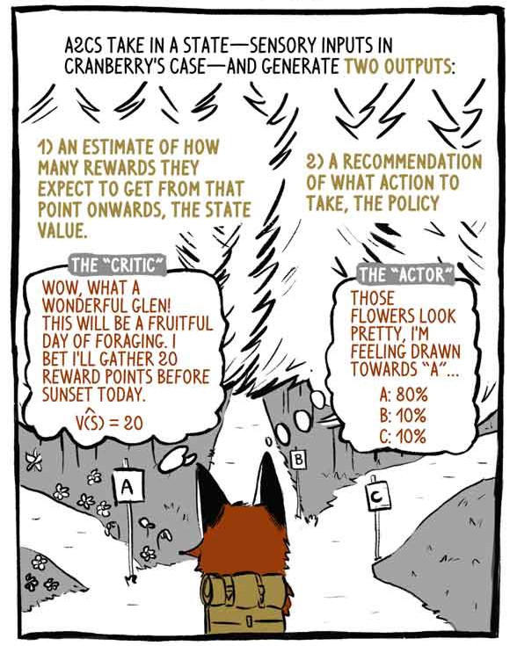
A2C/A3C

Slide 13
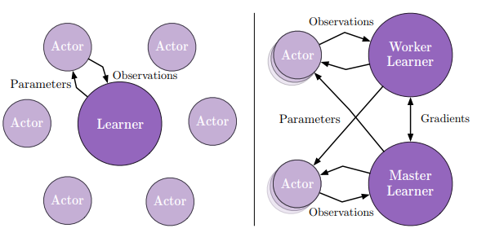
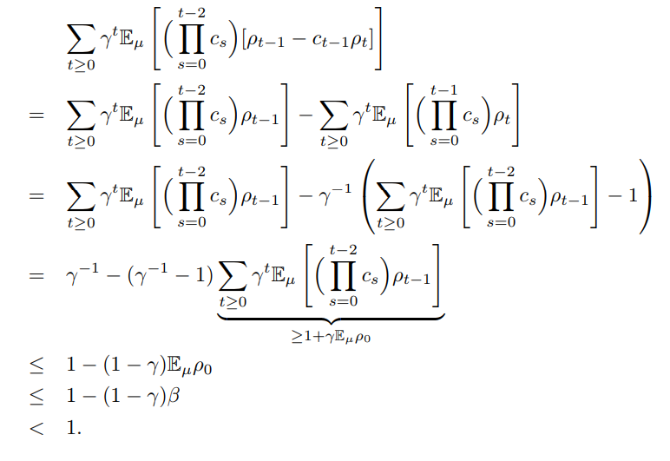
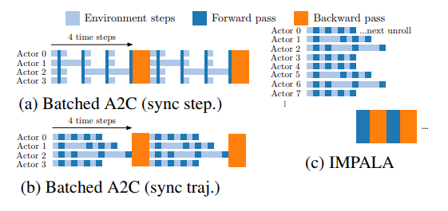
Impala

Slide 14
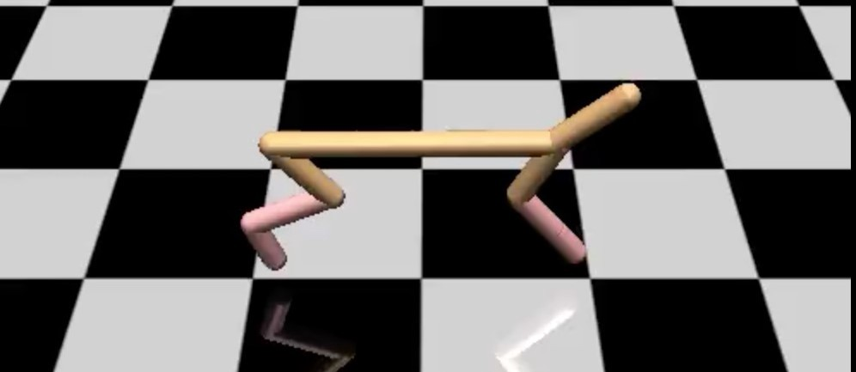
Environments

Slide 15

OpenAI gym

Slide 16

DMlab

Slide 17
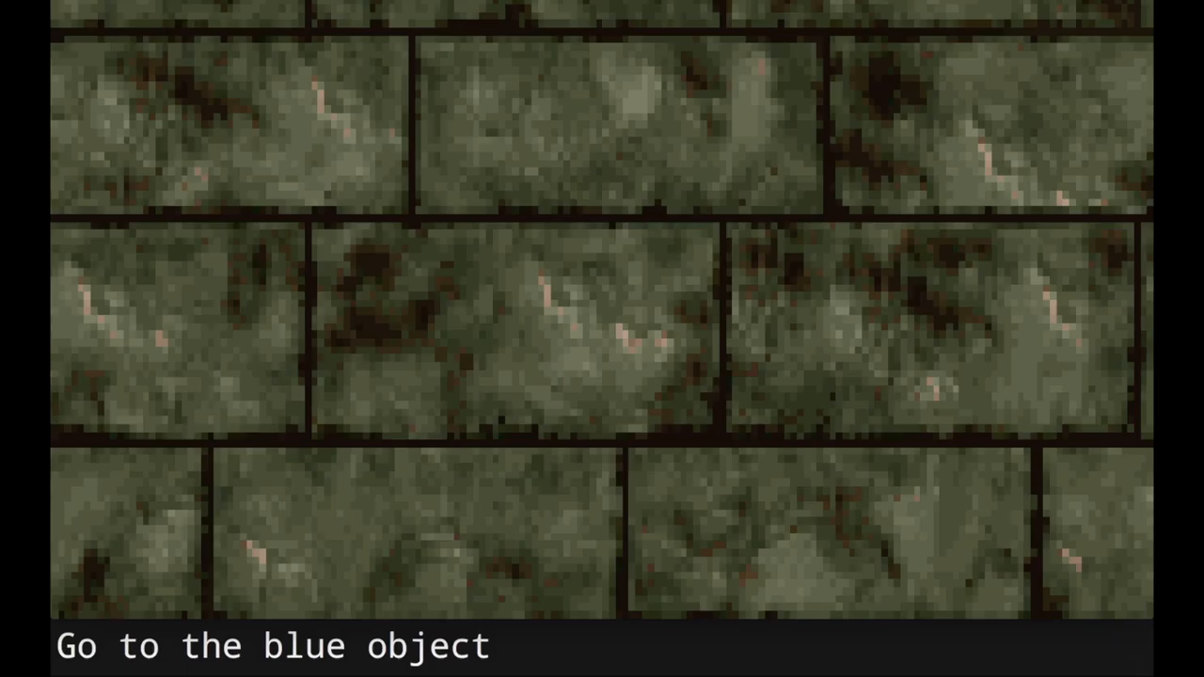

Slide 18
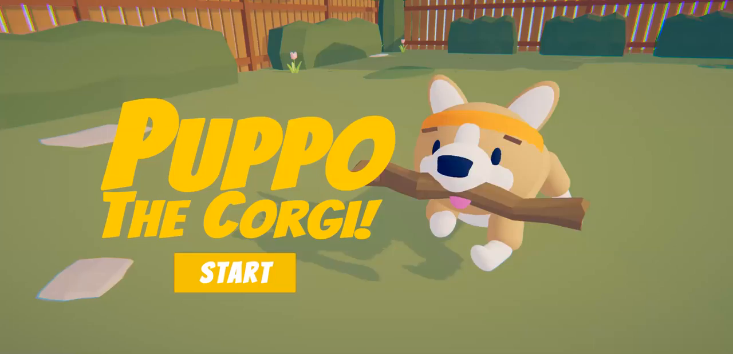
Unity

Slide 19
Links
https://spinningup.openai.com/en/latest/
https://ray.readthedocs.io/en/latest/rllib.html
https://hackernoon.com/intuitive-rl-intro-to-advantage-actor-critic-a2c-4ff545978752
https://openai.com/blog/
https://deepmind.com/blog/
https://distill.pub/

Slide 20
Environments
https://github.com/mwydmuch/ViZDoom
https://gym.openai.com/envs/#classic_control
https://github.com/deepmind/lab
https://unity3d.com/machine-learning/

Slide 21
Whitepapers
https://www.cs.toronto.edu/~vmnih/docs/dqn.pdf
https://arxiv.org/pdf/1707.06347.pdf
https://arxiv.org/pdf/1802.01561.pdf
https://arxiv.org/pdf/1602.01783.pdf

Slide 22
Wingman
https://wingman.ai/careers/

